Slide 1
Why “Getting Real” Requires Being “Radical” in High Stakes Education
Rochelle Gutiérrez, University of Illinois at Urbana-Champaign
The Iris M. Carl Equity Address given at the annual meeting of the National Council of Teachers of Mathematics. New Orleans, LA. April 11, 2014.

Slide 2
TODOS 2014 Beyond Awareness ~ Equity, Access, and Achievement for All
June 26th - June 28th, 2014
Sheraton Wild Horse Pass Resort & Spa
Phoenix, Arizona
Registration is limited so register soon!
$250 ~ Members $280 ~ Non-members
www.todos-math.org

Slide 3
Overview
Mathematics/teaching as political activity
Forms of knowledge necessary for teaching
What is Creative Insubordination?
Teachers using Creative Insubordination
What can you do?

Slide 4
Why did you seek teaching as a profession?
Introduce yourself and then discuss with the person in front or behind you [3 min.]

Slide 5
Not likely reasons to teach
Excel at racing students through a curriculum so you can cover all learning objectives
Want to create materials for or help “market” the latest teaching products of for-profit corporations
Goal is to teach kids that there are some people in society who are good at math and some who are not
Good at being on the “same page” as other teachers covering the same content
Feel energized by the uncertainty of your job based on students’ latest test scores

Slide 6
Stand up if…
Want to change the world in some small way
Unwavering belief in kids and the kinds of things they can do given the right context
Love mathematics and want to show others that it’s much more than numbers and memorizing disconnected procedures
An “educator” once believed in you and risked something to support you

Slide 7
Teaching in a high stakes era
Negotiate their practice with colleagues, students, parents, admin., for-profit organizations (e.g., defn. of math, education)
Work with fewer material & human resources
Support students to compete on unfair playing field
Buffer themselves from images of students (e.g., unmotivated, lacking “grit” or role models, cultural/linguistic issues to overcome)
Ignore images of teachers as slackers, saviors, or those who could not obtain work elsewhere

Slide 8
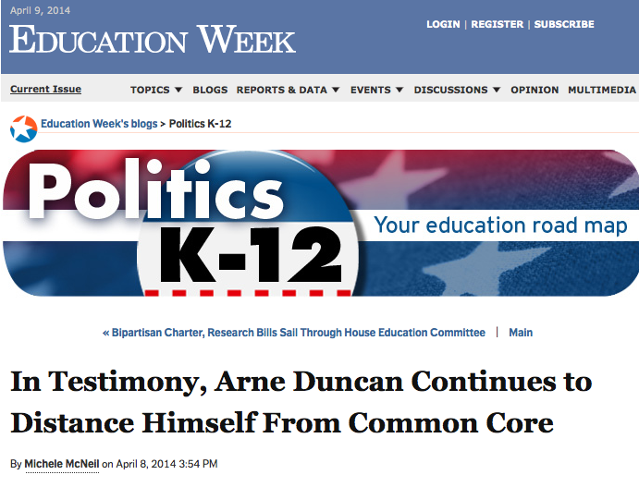
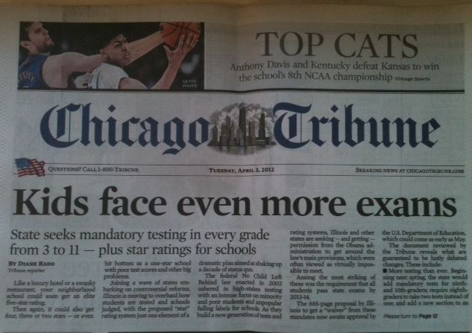
U.S. education secretary sticks by charter schools, measuring teachers by student results
Notes:
Teaching has always been political, but we’re at a point in history where the attacks on public education are extreme and where corporate America is weighing in a little too much for most teachers.

Slide 9
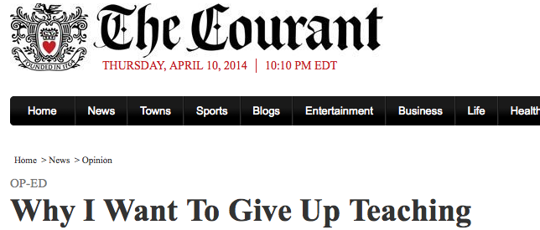
Surrounded by piles of student work to grade, lessons to plan and laundry to do, I have but one hope for the new year: that the Common Core State Standards, their related Smarter Balanced Assessment Consortium testing and the new teacher evaluation program will become extinct…
Notes:
Every day we see talented, committed individuals who are reconsidering whether teaching will allow them to be the people they want to be.

Slide 10
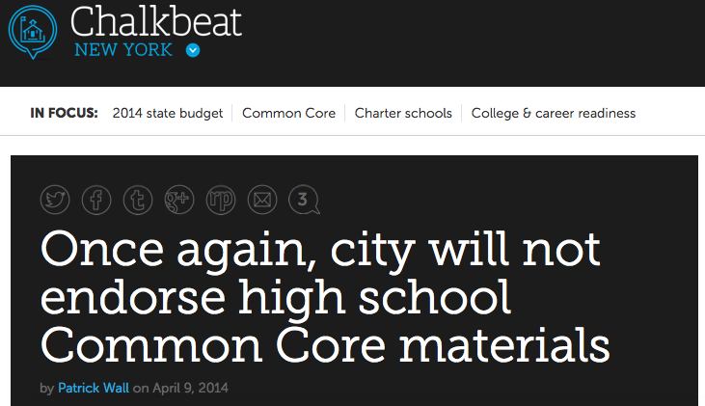
Notes:
Yet, there is a movement and growing resistance. Parents, teachers, students are standing up for themselves and their visions of education that move beyond testing.

Slide 11
13-year-old sent to principal’s office after informing students of Common Core opt-out rights (The Daily Caller)
Notes:
Aided by teachers who are telling their stories, journalists are doing the detective work on highlighting the lack of transparency in current attacks on public education.

Slide 12
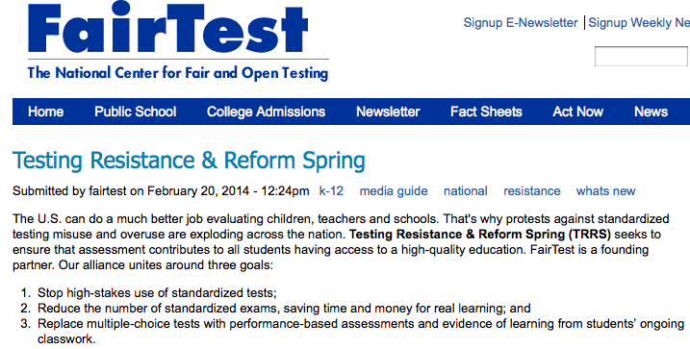
Notes:
Individuals are joining forces with others to reclaim the profession. Not extreme (get rid of all testing)– educators are thinking about what is the proper role of tests and what other forms of evaluation can inform learning?

Slide 13
What should educators know?
Pearson has a $32 million contract to administer tests with the state of NY; $500 million in Texas (Phillips, 2014)
Long history of errors in scoring or delays in reporting scores; design flaws; insufficient memory in systems for testing
Students’ test scores influence not only teacher’s salaries, but kids’ chances of getting into the next level of schooling, also the society’s belief in public education
For profit corporations are becoming in control of not only tests used to decide who stays in teaching, but also who becomes a teacher in the first place (e.g., EdTPA)
Pearson’s EnVisionMATH found to exaggerate claims of impact and generalizability to students of all ability levels, while grossing a minimum of $320 million/year on this one product, with potential revenue stream of $2 billion/year. (Singer, 2014)
Fueled by Race to the Top money, charter schools popping up everywhere (KIPP and other charter schools play by own rules; Pearson owns Connections Academy a group of virtual charter schools)
Corporations encourage new standards (yet little new content)
Notes:
Talk about how CCSS is really just Adding it Up report plus NCTM Principles and Standards; moves away from equity position statement that suggests students be connected to cultural roots and history, no mention of equity; accommodations for English learners are in an appendix
It’s not always easy to unravel all of the different interest groups and activities in education. I say this as someone who has been on the PARCC Core Leadership Item Review Committee in Mathematics helping to revise national test items.

Slide 14
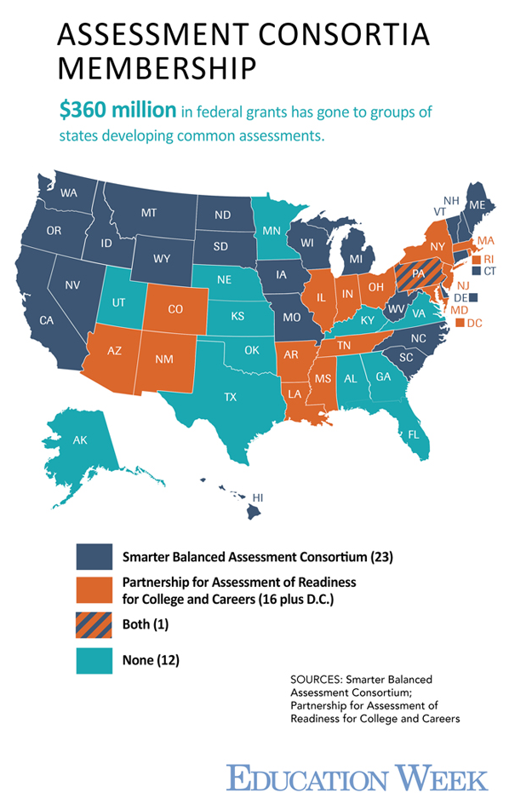
Notes:
Perhaps as a result of growing unrest, more states are pulling out of the consortia and are choosing to build their own assessments. Florida is a recent case. [Denver teachers protested following day]
To this point, most of what I’ve discussed about the politics of teaching mathematics has been about testing, teacher evaluations, charter schools, and connections to for-profit organizations. Let’s look a little more deeply at the politics of mathematics.

Slide 15
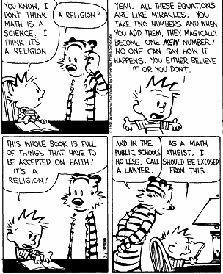
Math as
Religion?
Notes:
We might all laugh at this Calvin and Hobbes comic where Calvin is suggesting mathematics is a religion. But, there are a lot of ways in which mathematics requires believing a particular paradigm and way of doing things in the world. It carries with it a set of values that are transmitted every time we participate in the act of doing or using mathematics.

Slide 16
Mathematics is political
(Gutiérrez, 2013a)
Formatting power on our lives; objective; arbiter of truth
Ordered universe; things proven stay proven; license to control
Highest form of reasoning (abstract) requires absence of intimacy/context; deviance = abnormal/primitive
Measure of intelligence
Holds unearned privilege in society; like whiteness; seen as reflection of natural world
Notes:
Add notes here

Slide 17
All mathematics teaching is political
Only question is whose politics are we following?
➔ All math teachers are “identity workers,” regardless of whether we view ourselves that way
Always contributing to identities of students that position them, not just in school but in society
Always re(producing) what mathematics is and how people can relate through it
Notes:
We know from studies of adults who have reflected back on their experiences in mathematics classrooms that there is a lot of trauma

Slide 18
Do “effective” mathematics teachers see their work as political?

Slide 19
Effective Mathematics Departments
(Gutiérrez, 1995; 1996; 1999; 2000; 2002a,b; 2008)
Non-selective schools; free/reduced lunch
Students taking more mathematics courses than required by district
Large percentage of students taking advanced mathematics courses (Trig, Pre-calculus, Calculus)
Scoring better than predicted on standardized tests
Large percentage of students continuing onto college
Students representative of school population
Students see mathematics as something normal that they do

Slide 20
Building identities
I mean, besides the academic benefits of possible college credit, the grades, I think they get, there's somewhat of an esprit de corps like "we are the smart kids, we are the cool kids, we are the, kids who went together over the summer, we've been through something together,” that I think is valuable…I also think that Union as an integrated school has this effect…kids from different cultures working together...there's a kind of nice spirit of people working together at a high level seeing each other as achievers, as smart, you know, the smart kids are not of one race. (JS004, 4)

Slide 21
I mean I think there’s a million things we can do to like educate, organize, the vision, I mean I think we more than anything provide a vision for kids…having them believe in themselves, having them believe in themselves as a group, having them be able to do math as a group, having them believe they can go to college as a group…and then at a whole other level, it's like a political level…my way of teaching tries to organize them to be actors rather than acted upon… [EH001, 5, 7]

Slide 22
Writing counter narratives
That’s part of what drives my teaching because I got sick of the racists I used to work with in the [wood working] shops. I mean, some really nice guys. But, their image of inner city kids is like, every stereotype you can imagine. You know, and partly I’m teaching cause I want to say “In your face!” you know, it’s like, these kids are just as good as the New Trier [prestigious school] kids. (BL005, 14)
Notes:
This was different from the work in social justice mathematics that suggest the curriculum will be changed or that math will be a tool for analyzing societal inequities and making changes in society. His words are suggesting that the thousands of everyday practices and interactions he engages in are a form of challenging the discourse about Black and Latin@ youth.

Slide 23
Importance of teacher community
I think, many many teachers get overwhelmed by the demands of the job and feel punched around by the bureaucracy or the principal or other teachers. It's complicated so it's really hard as an individual to kind of maintain a stance of believing in kids and, and constantly thinking of new and creative ways to move them forward. And… I think having other teachers, particularly other math teachers [in the department] that have a similar stance and similar ideas, I think that we help each other continue to be creative and idealistic and non-alienated. [EH01, 6, 7]
Notes:
Stand up if you have ever felt overwhelmed by the demands of the job, felt punched around by the bureaucracy or the principal or other teachers. Now, stay standing (or stand up) if you feel you have a core set of teachers you interact with on a regular basis who help you continue to believe in kids and constantly think of new and creative ways to move them forward.

Slide 24
Current Visions of Teacher Knowledge (Shulman, 1986)
Content
Knowledge
Knowledge of
Students
Pedagogical
Knowledge
Notes:
After years of researching effective mathematics departments, I was eager to help build more places like the ones I had found. I was particularly interested in what kinds of experiences and knowledge bases teachers would need to have in order to become advocates for all students to develop deep understandings of mathematics and robust mathematical identities. When I looked at the knowledge bases typically emphasized, I did not see anything that acknowledged the political nature of teaching that individuals had described

Slide 25
Political Conocimiento for Teaching Mathematics
(Gutiérrez, 2012)
Histories
in
Society
Content Knowledge
Pedagogical
Knowledge
Knowledge “with”
Students/Communities
Political
Knowledge
Community en el Mundo Zurdo
Notes:
I’m arguing that another form of knowledge needed for teaching is political knowledge. This is the knowledge that helps you negotiate the world of high stakes testing and standardization; connect with and explain mathematics to community members and district officials; buffer oneself reinvent or subvert the system in order to be an advocate for one’s students. Conocimiento is the Spanish word for “knowledge,” yet it doesn’t mean an objective form of knowledge like knowing your times tables, it means a connection with people or objects/places. Political conocimiento means teachers have a stance on teaching that includes connection with mathematics and solidarity with others.

Slide 26
Teachers need political conocimiento
Professional development around PCK not enough (Gutiérrez, 2004; Jilk, 2010)
Back-to-Basics movement in district
Administration derailed successful efforts
Some political knowledge extended their efforts (e.g., IMP)

Slide 27
Creative insubordination
(Gutiérrez, 2013b; Gutiérrez & Gregson, 2013)
Counter-narrative to the achievement gap (Gutiérrez, 2008; Gutiérrez, & Dixon-Roman, 2011; Boaler, 2005)
Questions forms of mathematics in school
Highlights the humanity/uncertainty of math (D’Ambrosio, 2006)
Positions students as authors (Lawler, in press; Povey et al., 1987)
Recognizes that math needs people (Gutiérrez, 2002)
Recognizes everyday practices can subvert power dynamics (Butler, 1999; deCerteau, 1980; Foucault, 1980)
Notes:
If all mathematics teaching is political, then any form of mathematics teaching that challenges mainstream views of mathematics or who is capable of it can be seen as subversive.
Beyond the achievement gap (my work on challenging discourses that position students of color as inferior; seeing learning/advancement through students futures; subverting surveillance practices in schools—bubble kids told by outside sources)
Math needs people—(my work 2002 that suggests we might have a different form of math if marginalized people were to go into the field; ask different questions, have different purposes)
Humanity/Uncertainty of math—beyond using math for social justice purposes, being able to show students that math is created and they can contribute to its creation
Positioning students as authors—both in mathematics and in the classroom
Everyday practices

Slide 28
Dimensions of Learning/Equity (Gutiérrez, 2007; 2008b; 2009)
Access
Identity
Dominant
Critical
Nepantla
Power
Achievement
Play the game/Change the game
Notes:
One of the things I’d like to do is challenge us to think about EQUITY in more sophisticated ways
Helping students both play the game, and change the game.
As educators, we need to be clear on our stance--that we are advocates for our students to do both. Doing so requires situating ourselves in the tensions that exist in this work (Nepantla)
Requires being willing to take risks
Ultimately, students should have a window/mirror in terms of what they experience in the curriculum

Slide 29
If we expect our students to be able to play/change the game. . .
We need to be able to play/change the game
That means challenging weak definitions of equity like “achievement gap,” or defining “success” around a portion of our students.
Notes:
I’d like to shift gears here and talk about some work I’ve been doing with pre-service and in-service teachers over the past 6 years.
I won’t go into the details of how this is accomplished (I have papers you can read on the model that my research group and I have created)
Suffice to say that among the many other things that serve as professional development, one portion involves rehearsing how to respond to political situations in teaching. We call this “In My Shoes,” where a teacher will throw out a difficult situation they faced (could be a racist comment from a colleague, students resisting writing in their math journals because that’s not math), then others around the table ask questions and make suggestions of what they might have done if they were in that person’s shoes. The point of the activity is not to come up with the “right” answer or to guess what the person in that situation actually did, but rather to get more comfortable with the kinds of situations that teachers are facing on a regular basis and the uncertainty that accompanies teaching. Partly as a result of doing these kinds of activities, teacher I’ve worked with have developed political conocimiento and have become advocates for students.
I’m going to share a few examples of teachers using creative insubordination to accomplish their goals in those sticky situations.
So, what are the results of

Slide 30
Challenging the ACHIEVEMENT GAP
So, we had a dept meeting recently. And, the director started talking about the achievement gap data that we were looking at between Asian students, white students, African American students, Hispanic students…
He said something like: “The other school in the district has fixed that issue and has been able to decrease the gap between African American students…But, we have not fixed that yet.” And, a teacher said, “Well, do you know like maybe why that is?” And, he said “Well, anecdotally, and this is all I know just from what I see, their peers don’t encourage the kind of behavior that would be helpful to learning in the classroom. They kind of have this culture of grouping around, so they don’t really, they don’t really, it seems like that helps them to disengage.”

Slide 31
Discuss with person next to you
What (if anything) would you do if this was said at a school wide meeting where you were in attendance? [You are in the 1st month of your 2nd year of teaching]—3 min.

Slide 32
Other teachers have said
Say nothing, but return to my classroom and do mathematical activities that align with the culture of students
Announce that we should work with students and their cultures. Build lessons that draw on their culture.
Suggest we figure out what other school did that allowed them to close the gap
Ask other colleagues what they think (and hope they will not draw on deficit frames)
Stand up to the racist and essentializing comment about all black kids and disengagement. Emphasize that it is not true.
Notes:
When I’ve shared this scenario…
If you were going to stand up to that racist comment, what would you say?
Its easy to say you would say something, a lot harder to come up with the words.

Slide 33
I kind of looked around. There were 25, maybe more, teachers in that classroom, because we all had to be there for the department meeting for my school. And, no one said anything, and it was like passing on 5 seconds.
Like, one one thousand, two one thousand, three one thousand, and I looked around and was like “Really, no one is going to say anything to that?” …So, I finally chimed in. I said, “I know this isn’t want you mean to say. It sounds like you are saying it’s their fault. But, obviously that’s not what you are saying. So, I just want to make sure that we’re noting that there’s a long history of oppression with respect to that group that’s still happening today and that’s probably a lot of the reasons we see what we see.”
He looked at me and was like “Right, right, right. That’s what I mean.” My heart was pounding!! I was like, “Oh my gosh, I can’t believe I’m going to say something right now.”

Slide 34
Theorizing creative insubordination
I was thinking, “Did he really just say…” What he sounded like made it sound like it was their fault, that they, we see the gap that they make happen. Then, I was like “Really? We’re going to “fix the ‘problem?’ Really?” like that’s all we’re doing here? Like “check, like good job, we’ve done it.” Not even recognizing any history about it at all. Part of that is looking at this data without even thinking…So, there are some things going through my head like that. But,…okay this is also the boss and I’ve only taught one year. I don’t know how I’m going to say what I want to say without sounding like, “I straight out disagree with you” in a respectful way. I don’t know him that well to be able to talk to him in an honest way.
Or, even if it was just me and [the director], maybe that would have had a different conversation, too. [I was] Just feeling, a lot of fear. And, wanting someone else to say something so I wouldn’t have to….But, I have to let myself be known to people. This is the kind of person I am, this is what I believe in, and if you wanted to talk about something that is important with respect to race, I’m the kind of person to talk to.

Slide 35
Fighting for a rigorous curriculum
He showed me the curriculum, topics that I needed to cover. There’s like synthetic division, but there’s nothing else like…And, synthetic division is basically just an algorithm. And, I’m gonna have to just say, “it works.”
If I do that, there are a couple of things I’m going to obscure for them. They’re not going to be able to see a polynomial as a mathematical object. They will not be able to relate polynomial with integers. When we talk about groups, polynomial objects are very similar…They’re not going to have any relation with integer…so he asked me, “what’s up?” because I didn’t look very happy about it. Then, I gave him my points. How using synthetic divisions isn’t a good thing to do.
Notes:
It’s one thing to SAY you will fight against the system to be an advocate for your students. And, it’s a whole other thing to actually do it. Do they walk the walk, or just talk the talk?

Slide 36
I showed him how it only works for a monomial. The coefficient has to be one. The things we are teaching them only apply for a binomial. So, if you have a polynomial divided by a trinomial, they won’t be able to do it. Secondly, synthetic division is based on long division, seeing what happens when we divide the dividend with the divisor. So, at least the patterns…They’re not going to see any relationship. It’s just going to be rote, procedural teaching.
He said, “Okay, I’m going to let you include this in your teaching, but I’m going to give other teachers an option…” I still do feel like that is where we butt heads a lot, me and my coop. We always debate about what to teach. I don’t think he thinks a lot of kids will get this stuff. It’s hard to get support from my coop if I want to do more rigorous things.
Notes:
I need to comment that his coop was the department chair.
His form of creative insubordination became a form of “exception case” or similar to the “control case” with the teachers using IMP in the closet.

Slide 37
Theorizing creative insubordination
He [my coop] was upset with people messing with traditions. He has his own way of doing things, and he is set on them. He tries to be flexible. But, in terms of when it comes to his pedagogical approach, he’s very set on things. It’s hard for me. I don’t want to argue against him because I don’t want to step on his toes. I need to be wise in what I say so I don’t sever that relationship with my coop.
RG: How do you do that? How do you be wise in what you say?
I just think about it in my head, then I try to think about how he would take it. From there, I try to compromise my own words. I was going to say this, but I try to come up with a better wording. I try not to say things right away. I know that the issue is very fresh and he may think I am acting on impulse. I try to make sure there is no room for my statement to be misconstrued as I’m just challenging him. Trying to be wise in my timing on things. I know he feels pretty strongly about things and I try to my best of ability, weighing the risk and reward. Is this going to be something worth fighting over? A lot of times, I’ll say, “Let’s wait a bit and see what happens.”
Notes:
When I asked him what went through his head with respect to that situation
So, partly this is about him picking his battles

Slide 38
Questioning the Common Core
So this is what the Common Core responded by saying. They said "First of all you can't field test standards, you can field test implementation of standards but you can't field test the standards themselves. So when people say that they have not been field tested, it does not make sense to say that either because this is the bar that we are setting. You can't field test a bar.
So, just as they were talking I started thinking about it a little bit and, there were many parts that I disagreed. And they gave you no point in their 2-hour speech to disagree. They never gave you any time to ask yourself if “that made sense." So my first thought was, “You are claiming that these standards are getting you ‘college and career ready’ and if that is the case, then those standards can be field tested. You can decide if they do make you college and career ready and what is to say what college and career ready is, who decides that?” Those were some questions that I had in the back of my head about the common core.
Notes:
One teacher shared her experiences at a common core conference. The first day, she was happy with the kind of information that they presented—they gave more details on how to understand the standards, how to gauge if you are doing them correctly in your classroom. But, the second day really worried her. It felt a lot more like indoctrination. They talked about what are common critiques and what are responses to those critiques.

Slide 39
Learning how to deconstruct others’ arguments
And then one other thing that they added in this common core, you know, anti-critiquing business was that, the testing portion, because there is a massive amount of money going into the testing of the common core…So they said. “Well a lot of people are worried that a lot of money is being spent on testing but really if you break it down it is 20 dollars per student. Every student is allotted about $6,000 per person and that is how it works. So really when you compare, $20 is not a big deal.” I think as math people we particularly have to be aware when some people say something like that, because $20 per person that is not how, that is not how schools spend money. Schools spend money with aggregates. Like, here we have thousands of students; we are going to use 5 thousand of those dollars into this. And when you say $20 dollars per student you have to think aggregate. And $20 dollars per student is a lot of money that probably could be going into something a lot more useful than testing. So it is just another flag to see how they manipulated the statistics so that it sounded like, okay two cups of coffee no big deal, when it is a little more than that.
Notes:
This teacher also mentioned that they had professional speech writers to help people create testimonies on the spot that could be video recorded. They also learned how to write critiques of anti-Common Core articles.

Slide 40
Focusing on language
T2: Oh so the last thing that I was going to say is that right now we are piloting the Common Core algebra 1 course and I am one of the teachers teaching that and at the beginning of the summer what they did is that they gave out the list of standards and they were like , “Teach them.” You know, so its craziness, Even more so in terms of like not really giving us much professional development so we don’t know what we are doing. We have to come up with this stuff ourselves.
T1: That was one of the critiques that they said about the common core and this is from the Common Core people and they said,"Well if you are a teacher, well yeah, there are going to be some changes and you kind of have to roll with them, like you have to figure this out, I mean it is time for some tough love."
Notes:
Another teacher also shared her experience with the Common Core at her school and how it has forced her to become a curriculum developer as a first year teacher.

Slide 41
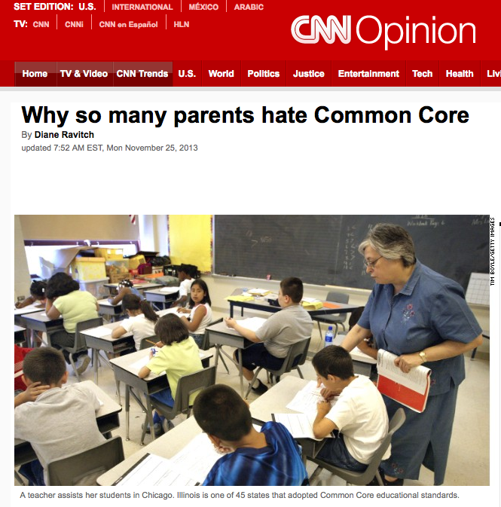
Learning to Advocate for Oneself
So the other day, I actually got an article from them…and they were like, “This is a critique of the common core. Remember how we learned how to write in the comments section that supports the common core? This is a great opportunity for you to try it on this very article!” I didn’t do that; instead I emailed it to all you guys.
Notes:
NOTE: On Pearson’s “My Education Community,” teachers can earn “merit badges” for commenting on articles, blogs, or show how using products have helped them. Not sure who they would show these badges to, but they are being marketed as a form of professionalism.

Slide 42
Challenging Others to Advocate
Just one last thought which is, uh, so I think this is especially important in this time to do things with courage. Especially, when it comes to our classroom. Um, I know that, you know, Common Core says this is what's good for kids, …and I think if we don't take a moment to actually think what's good for kids [ourselves] and just believe, you know, whatever they say is good for kids is actually good for kids. Then we might be doing some real damage. And I just have to remind myself, like, in the end what do I want to see? I want to see citizens in the future that are going to be kind, thoughtful, encouraging, critical, interesting and confident. And sometimes some of the things that we're doing to students can really be harmful. I just encourage, you know, all of you guys and myself to when you get into the classroom, like, do what's right and not just what everyone says is right.

Slide 43
What we learn from teachers with political knowledge
Recognize creative insubordination is necessary if going to become the teachers they want (rigorous/creative/humane math, social justice, robust mathematical identities)
Able to identify injustices in schooling (students denied ability to speak home languages, work needs to be shown the “right” way, unjust policies in schools, over reliance on testing to measure learning, etc.)
Mere exposure to the kinds of political situations that require creative insubordination may support teachers to identify and critique similar situations in their own teaching.
Learning to advocate for students helps advocate for oneself as teacher

Slide 44
What can you do to develop your political knowledge?
Use privilege: leaders are not rule followers
Develop political clarity (take a stand!)
Do students, colleagues, others see you that way?
Be open to risk-taking (but pick your battles)
Consider a variety of approaches for Creative Insubordination (Gutiérrez, in preparation)
Press for explanation (e.g., accountability)
Counter with evidence (e.g., educate)
Use the master’s tools
Seek allies
Turn a rational issue into a moral one
Fly under the radar
Notes:
Press for Explanation--(accountability; allow them to talk; buy time)
Counter with Evidence--(what evidence do I/we have that suggests a counter-narrative or opposing perspective?)
Use the Master’s Tools (find ways to align your goals with written or oral statements of those in power, formal documents; “data gathering”; “control case”; test prep by giving answers first to focus on concepts)
Seek Allies: Find others who are more adept at certain practices than you are; rely on your colleagues to revoice your points during faculty meetings (better to prepare for this with a mini meeting talking about who will say what before the actual meeting). Don’t look just to your math department for allies. Could the social studies teacher, Spanish teacher, curriculum coordinator be the person who you can talk candidly with?
Turn a Rational Issue into a Moral One (are we on high ground?)—Is this what we want to stand for (or be remembered by) as a department/team/school/teachers?
Fly Under the Radar--(don’t engage; just decide to do what you want to do and don’t tell people until you have good evidence or a track record; can't do this too often; not illegal things, more like students working in groups, student leadership teams that inform your teaching)
These aren’t necessarily distinct approaches, some may blend together

Slide 45
Language and context important
Use non-threatening language (e.g., “I wonder,” “I’m new here,” “Tell me more”) to create dialogue
Don’t do this work alone
If we are going to be real (rational & irrational) with our students, it’s going to mean some radical work on our part.
Notes:
Don’t do this work alone—The media tends to present images of the lone teacher (Jaime Escalante) who is out there fighting the system on behalf of students. Yet, any successful activist will tell you that there is no “movement” without a body of people working together. When you work with others, you don’t have to reinvent the wheel, you have people to bounce your ideas off of; to reaffirm your stance when you start to get discouraged; to share their success stories. And, don’t think of colleagues as your only allies. How can community members, students, administrators also become allies?
Also, don’t look down on others who are not doing what you think they should do. Have empathy. I have never met a teacher who went into teaching to put kids down, yell, lower expectations. Teachers are a product of their contexts. Also, don’t think because you do one social justice activity with your students once in the year that that makes up for any other forms of dehumanization that go on in mathematics classrooms. Constantly ask yourself what you are doing to rehumanize mathematics teaching and learning.
I come back to the title of my talk and reinforce that real numbers include the union of rational and irrational. In a similar manner, our actions must be both rational and irrational—that is, we must be viewed as rational by others but not always follow the rationality of others “if we’re going to be real with our students, its going to require some radical work on our part.”

Slide 46
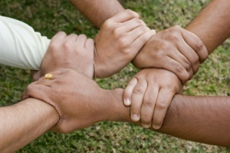
Never doubt that a small group of thoughtful, committed citizens can change the world. Indeed, it's the only thing that ever has.
--Margaret Mead
We are…the green shoot that cracks the rock.
--Gloria Anzaldúa
Notes:
This may feel daunting. But, we can never doubt.

Slide 47
Further Readings for Practitioners
Gutiérrez, R. (2009). Framing equity: Helping students "play the game" and "change the game." Teaching for Excellence and Equity in Mathematics, 1(1), 4-8.
Gutiérrez, R. (2013). Why (urban) mathematics teachers need political knowledge. Journal of Urban Mathematics Education, 6(2), 7-19.
Gutiérrez, R. (2013). Mathematics teachers using creative insubordination to advocate for student understanding and robust mathematical identities. Proceedings of the Annual Conference of Psychology of Mathematics Education North America. Chicago, IL.
Gutiérrez, R. (2008). A "gap gazing" fetish in mathematics education? Problematizing research on the achievement gap. Journal for Research in Mathematics Education. 39(4), 357-364.
Gutiérrez, R. (2009). Embracing the inherent tensions in teaching mathematics from an equity stance. Democracy and Education, 18(3), 9-16.
Gutiérrez, R. (2012). Context matters: How should we conceptualize equity in mathematics education? In Choppin, J., Herbel-Eisenmann, B., & Wagner, D., (eds.), Equity in discourse for mathematics education: Theories, practices, and policies, pp. 17-33. New York: Springer.
Gutiérrez, R. (2012). Beyond the achievement gap: What it takes to become an effective leader in mathematics for marginalized youth. In Theoharis, G. and Brooks, J. S. (eds.), What every principal needs to know: Instructional leadership for equitable and excellent schools, pp. 31- 54. New York: Teachers College Press.
Gutiérrez, R. (2012). Issues of identity and power in teaching Latin@ students mathematics. In Celedón-Pattichis, S. & Ramirez, N. (eds.). Beyond good teaching: Strategies that are imperative for ELLs in mathematics classrooms, pp. 119-126. Reston, NJ: National Council of Teachers of Mathematics.
Gutiérrez, R. (2002). Beyond Essentialism: The complexity of language in teaching Latina/o students mathematics. American Educational Research Journal. 39(4), 1047-1088.
Gutiérrez, R. (1999). Advancing Urban Latina/o Youth in Mathematics: Lessons from an Effective High School Mathematics Department. The Urban Review, 31(3), 263-281. Gutiérrez, R. (2009). Framing equity: Helping students "play the game" and "change the game." Teaching for Excellence and Equity in Mathematics, 1(1), 4-8.

Slide 48
Further Readings for Researchers
Gutiérrez, R. (2013). The sociopolitical turn in mathematics education. Journal for Research in Mathematics Education, 44(1), 37-68.
Gutiérrez, R. (2013). Mathematics teachers using creative insubordination to advocate for student understanding and robust mathematical identities. Proceedings of the Annual Conference of Psychology of Mathematics Education North America. Chicago, IL.
Gutiérrez, R. & Gregson, S. (2013, April). Mathematics Teachers and Creative Insubordination: Taking a Stand in High-Poverty Schools. Selected paper presented at the Annual Meeting of the American Educational Research Association. San Francisco, California. April, 2013.
Gutiérrez, R. (2012). Embracing "Nepantla:" Rethinking knowledge and its use in teaching. REDIMAT-Journal of Research in Mathematics Education, 1(1), 29-56.
Gutiérrez, R. and Dixon-Román, E. (2011). Beyond gap gazing: How can thinking about education comprehensively help us (re)envision mathematics education? In Atweh, B., Graven, M., Secada, W., and Valero, P. (eds.), Mapping equity and quality in mathematics education, (pp. 21-34). New York: Springer.
Gutiérrez, R. (2012). Context matters: How should we conceptualize equity in mathematics education? In Choppin, J., Herbel-Eisenmann, B., & Wagner, D., (eds.), Equity in discourse for mathematics education: Theories, practices, and policies, pp. 17-33. New York: Springer.
Gutiérrez, R. (2002). Enabling the practice of mathematics teachers in context: Towards a new equity research agenda. Mathematical Thinking and Learning. 4(2&3), 145-187.

Slide 49
Questions/comments?
Rochelle Gutiérrez
rg1@illinois.edu

